Slide 1
Mini-Project 3
Loan Approval Prediction Machine Learning
Neil Bhikha | Institute of Data

Slide 2
Predict Loan Eligibility for Dream Housing Finance company
Customer first applies for home loan and after that company validates the customer eligibility for loan.
Context
Company wants to automate the loan eligibility process (real time) based on customer detail provided while filling online application form.
Based on their answers they give, can we predict if they will be approved.
Mission
Application
Exploratory Data Analysis
Predictive models:
Decision Tree
Random Forest
Logistic
Notes:
Online application where they enter all their details
Automation will reject the applications that wouldn’t make it through and so they can focus on the ones that will go through

Slide 3
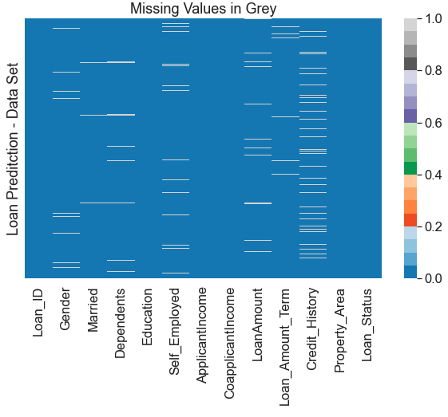
Data
614 Applicants
11 inputs that the customers have.
Missing value strategy:
Credit History has the most missing data
Numerical : Median
Categorical: Mode
Notes:
Credit History only has 8% of it’s data that’s missing
For numerical variables: imputation using mean or median
- For categorical variables: imputation using mode

Slide 4
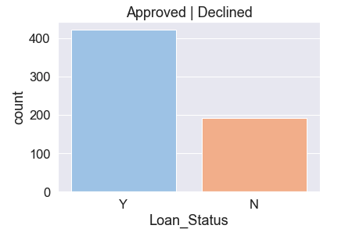
Target Variable
Loan Status
69% of the applicant had their loans approved
Categorical

Slide 5
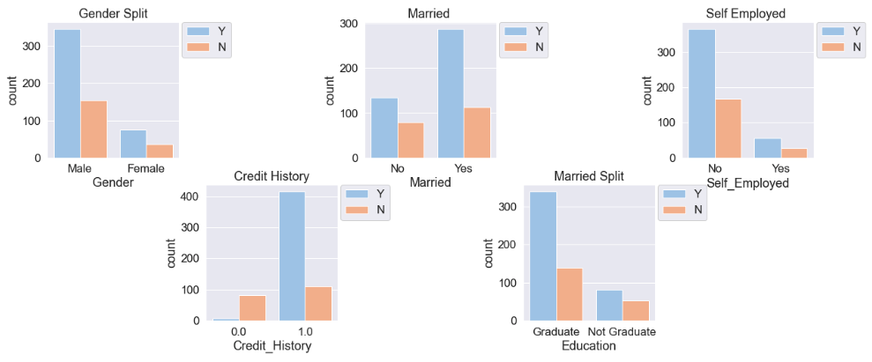
Independent Variables
Notes:
Gender: 82% of this data set is male. Maybe affected by the fact that males are majority primary applicants.
Noticed that income was split into income and co-income
Roughly a 70% approval rate for both genders
Married: 65% of applicants were married
8% better chance of approval if they are married
Self emp: 13% are self employed
Approval split was the same
Credit history: 86% of applicants had submitted a credit history
79% of applicants with a credit history were approved
Out of the 14% - 92% were declined!
Education: 11% difference between those that have graduated and have not

Slide 6
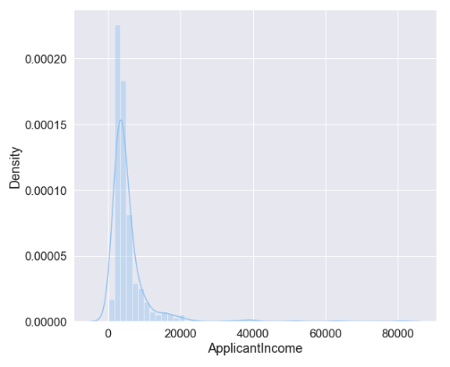
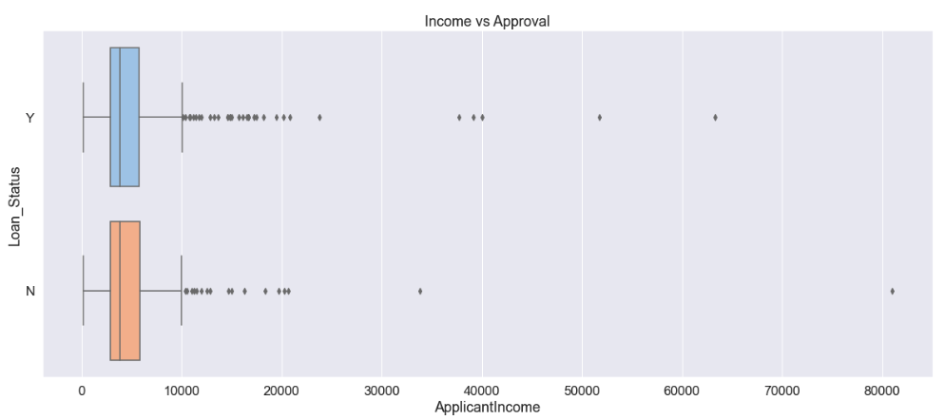
Numerical Columns
Notes:
Application Income
mean 5403.459283
min 150.000000
max 81000.000000
Loan for 81000 was declined
Distribution of it was normal with a slight right skew

Slide 7
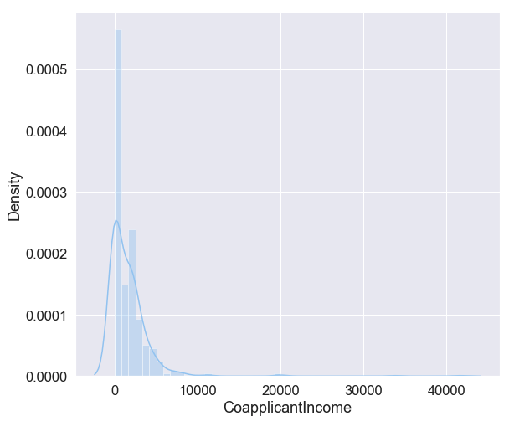
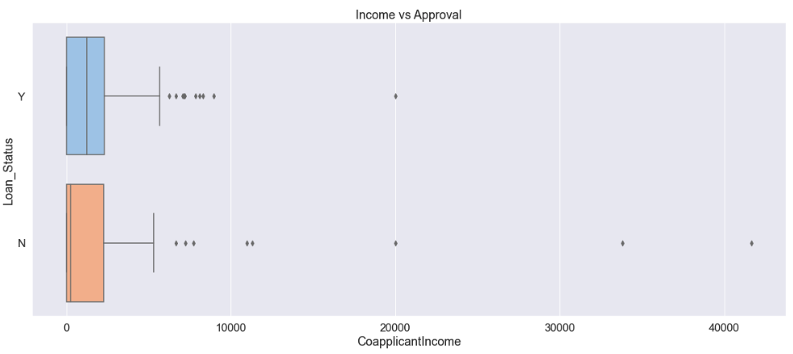
Co Applicant income
Notes:
No Income contributed from Co Applicant
273
mean 1621.245798
max 41667.000000

Slide 8
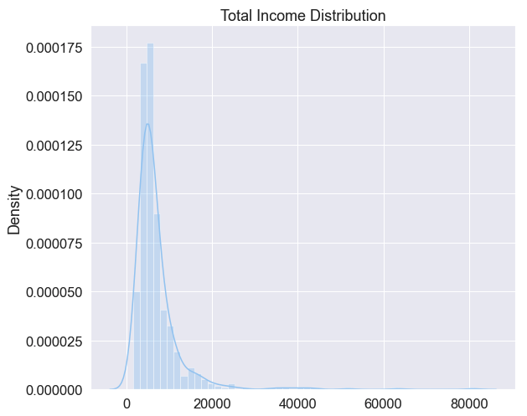
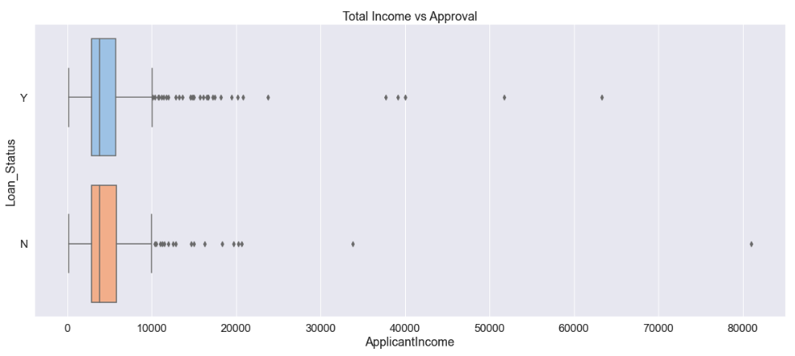
Total Income - Feature Engineered
Notes:
mean 7024.705081
min 1442.000000

Slide 9
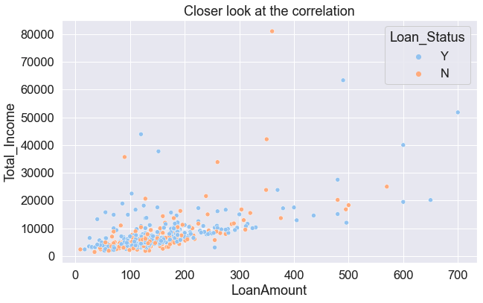
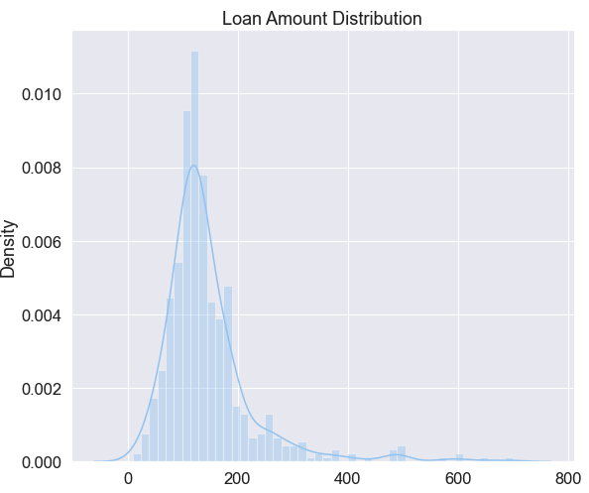
Loan Amount

Slide 10
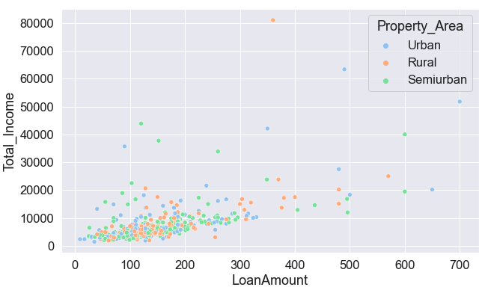
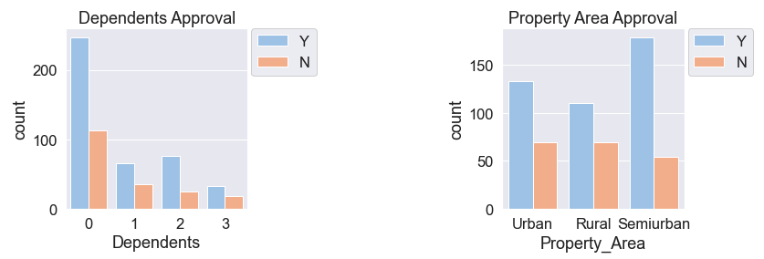
Dependents and Property Area
59% of applicants don't have children
Even around 65%-70% approval
Semi-urban 38% | 77% Approved
Urban 33% | 66% Approved
Rural 29% | 61% Approval

Slide 11
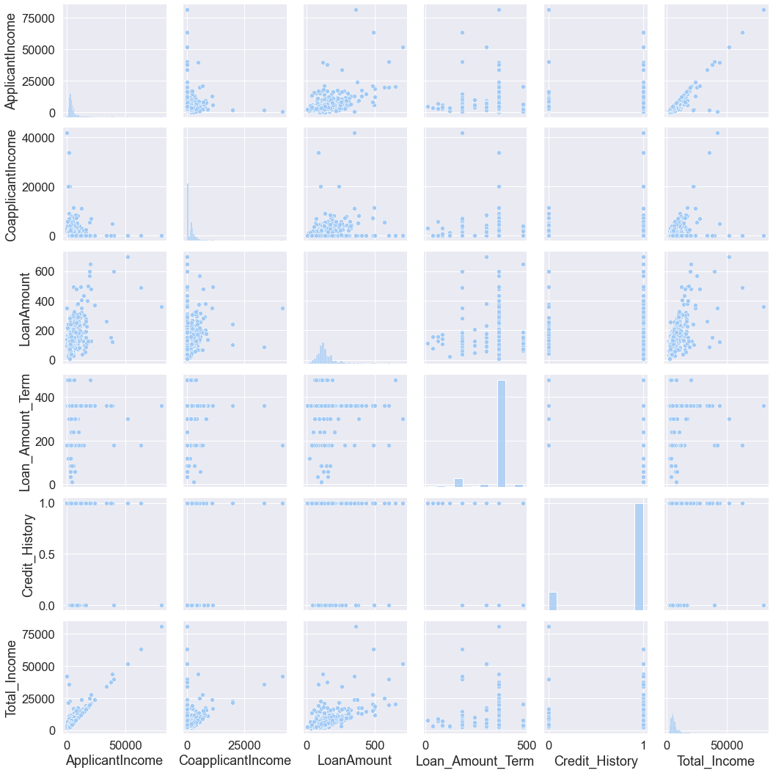
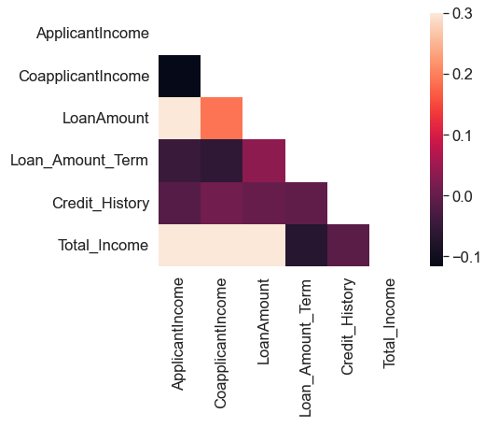
Correlation and Trends

Slide 12
Processing
Encode Data
Features
Target
Split 80/20
Notes:
Encoded data so we can put it through machine learning models
Features that I’ve left out were Applicant income and co applicants income - Total income is there
Target is Loan status
Train test split is 80/20

Slide 13
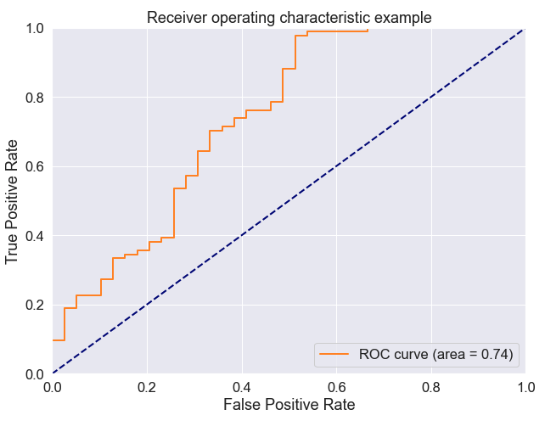
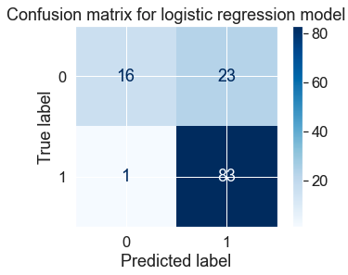
Logistic Regression
Train Score: 0.81
Test Score: 0.80
ROC curve: 0.74

Slide 14
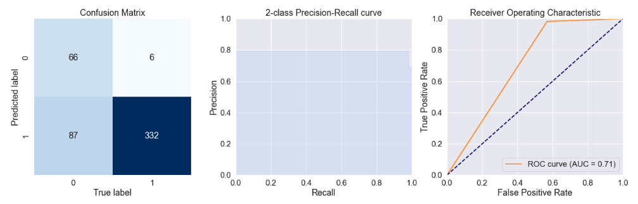
Decision Tree - Train
Accuracy: 0.81
Precision: 0.79
Recall: 0.98
ROC Curve: 0.71

Slide 15
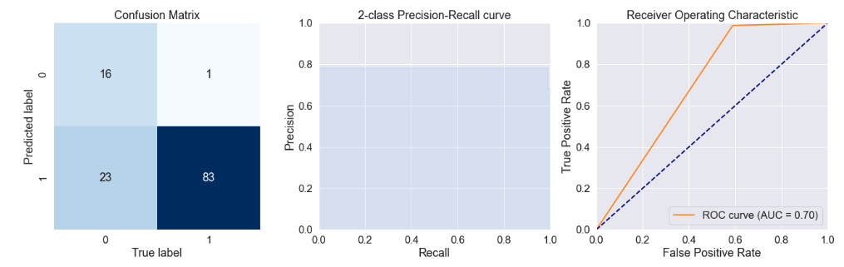
Decision Tree - Test
Accuracy: 0.80
Precision: 0.78
Recall: 0.99
ROC Curve: 0.70

Slide 16
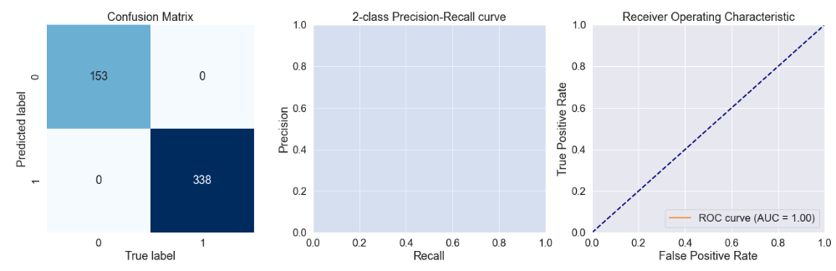
Random Forest - Train
Accuracy: 1.00
Precision: 1.00
Recall: 1.00
ROC Curve: 1.00

Slide 17
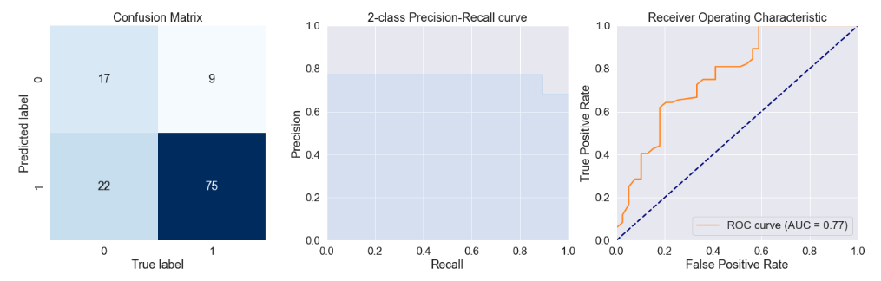
Random Forest - Test
Accuracy: 0.75
Precision: 0.77
Recall: 0.89
ROC Curve: 0.77

Slide 18
Conclusion
After trying three different methods Logistic regression and Decision Tree had performed similarly
Random Forest had overtrained the training data and had slightly lower results
What to try next:
Standardise the Numerical values
Remove outliers
Adding a new feature EMI: Equated Monthly Instalments and see if there is a trend
Adding the K-Fold method
XGBoost
Thank you

